Slide 1
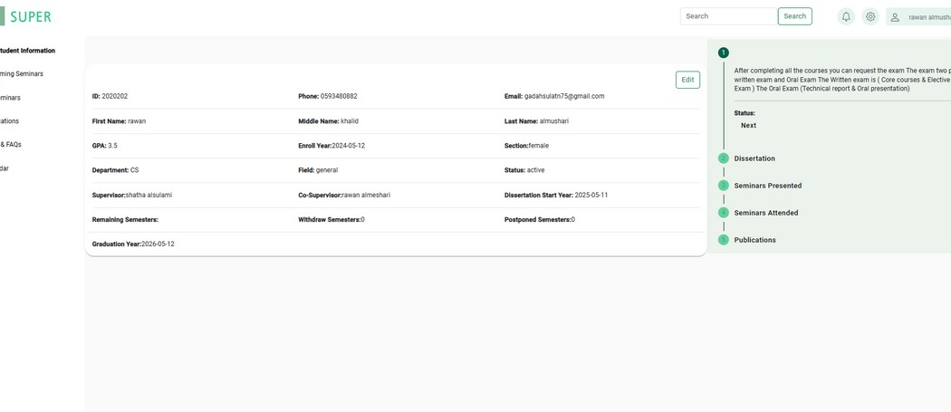
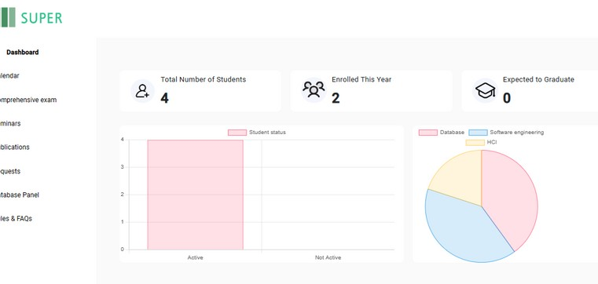
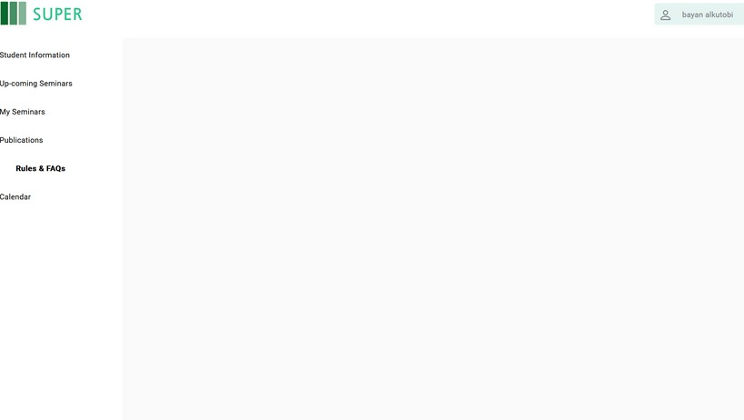

Fcit News
SUPER IS OUT
SCHOLAR'S UNIFIED PROGRESS & EFFICIENCY RESOURCE
GROUP 5
BASHAIER ALAMOUDI
GADAH ALMUAIKEL
SHATHA ALSULAMI
RAWAN ALMESHARI
Supervised by: Dr.Wafaa Alsagaaf
We are deeply grateful to Dr. Wafaa Alsaggaf for her invaluable guidance and expertise, which were crucial in shaping our project, SUPER. We also extend our thanks to the Faculty of Computing and Information Technology for their essential support.
ABSTRACT
SUPER is a web-based platform designed to streamline the PhD experience at King Abdulaziz University. It provides students and coordinators with tools for real- time progress tracking, academic calendar integration. This initiative aims to enhance the efficiency of PhD program management and improve graduation outcomes.
PROBLEM DEFINITION
Lack of Unified System
Management Challenges for Coordinators Monitoring Challenges for Students
SOULTION
OBJECTIVES
Build a Comprehensive Database Centralized Web Platform
Real-Time Management Tools for Coordinators
Keep students updated on important dates and deadlines
Ph.D coordinator
METHODOLOGY
Waterfall methodolgy
Ph.D student
TOOLS
RESULT

